Slide 1
Ghidra-LLM: Large Language Models for Static Reverse Engineering
Week 12 Update
Project 9: Bisesh, Mack, Maximilan, Craig, Justin

Slide 2
Review - Project Goal
In this project, our team will create large language model support for NSA’s new reverse engineering tool, Ghidra.
Reverse engineering is inherently a lossy process. Valuable context and data is often lost or obscured. Our goal is to use machine learning to bridge this gap.

Slide 3
Review – Project Process
Multi-step project that consists of numerous phases
Phase 1: Research & Red Teaming current LLM application (Current)
Phase 2: Improving current models (Late Fall – Early Spring)
Phase 3: Further refinement & integrating our new model into Ghidra (Spring)

Slide 4
Review – Phase 1
We are taking advantage of a current existing open-source large language model "LLM4Decompile".
This LLM already has the ability to decompile binary/assembly to C (Best version ~65% accurate)
Our current goal is to refine this LLM to become more accurate.
How do we accomplish this?

Slide 5
Team Objectives
Our team has the latest LLM4Decompile model running on our development environment
Hosting this model on ubuntu desktop provided by GMU, with code repository (github) https://github.com/SPIRE-GMU/SPIRE_GLLeN/tree/dev
With the model running, we can begin to test, improve, and refine it.
We have split into 2 teams to achieve these objectives
RAG Team – This team oversees building a RAG Pipeline that we will combine with LLM4Decompile to improve accuracy
Red Team – This team oversees evaluating the current LLM4Decompile model and determining where it falls short.

Slide 6
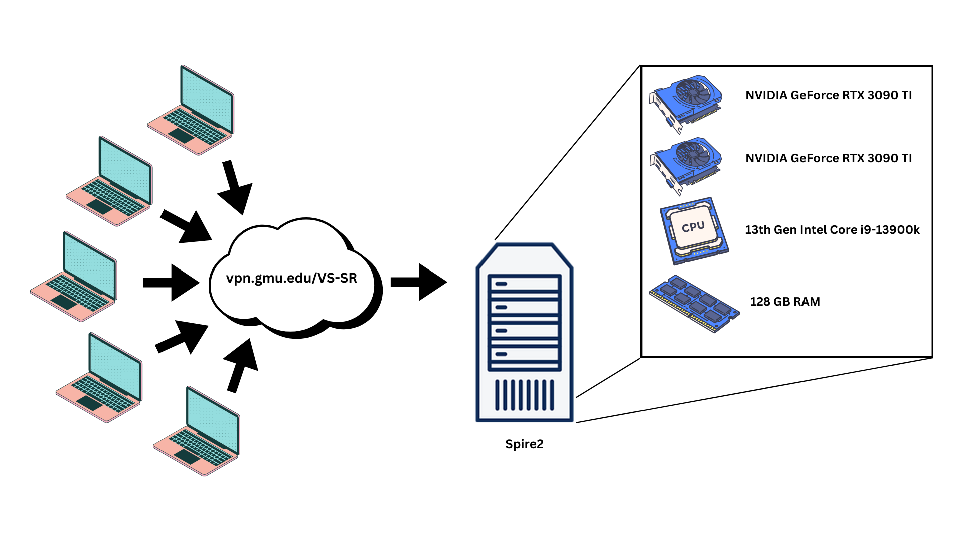
Lab Environment

Slide 7
Red Team (Mack, Max, Bisesh) Objectives – Last 2 weeks
Created code to automate bucket placement for uncompilable files
Wrote report on the 11,461 failure to compile files found over the past few weeks:
Created buckets to sort the kind of hallucinations
Show real examples of each
Began code writing for higher levels of optimization.

Slide 8
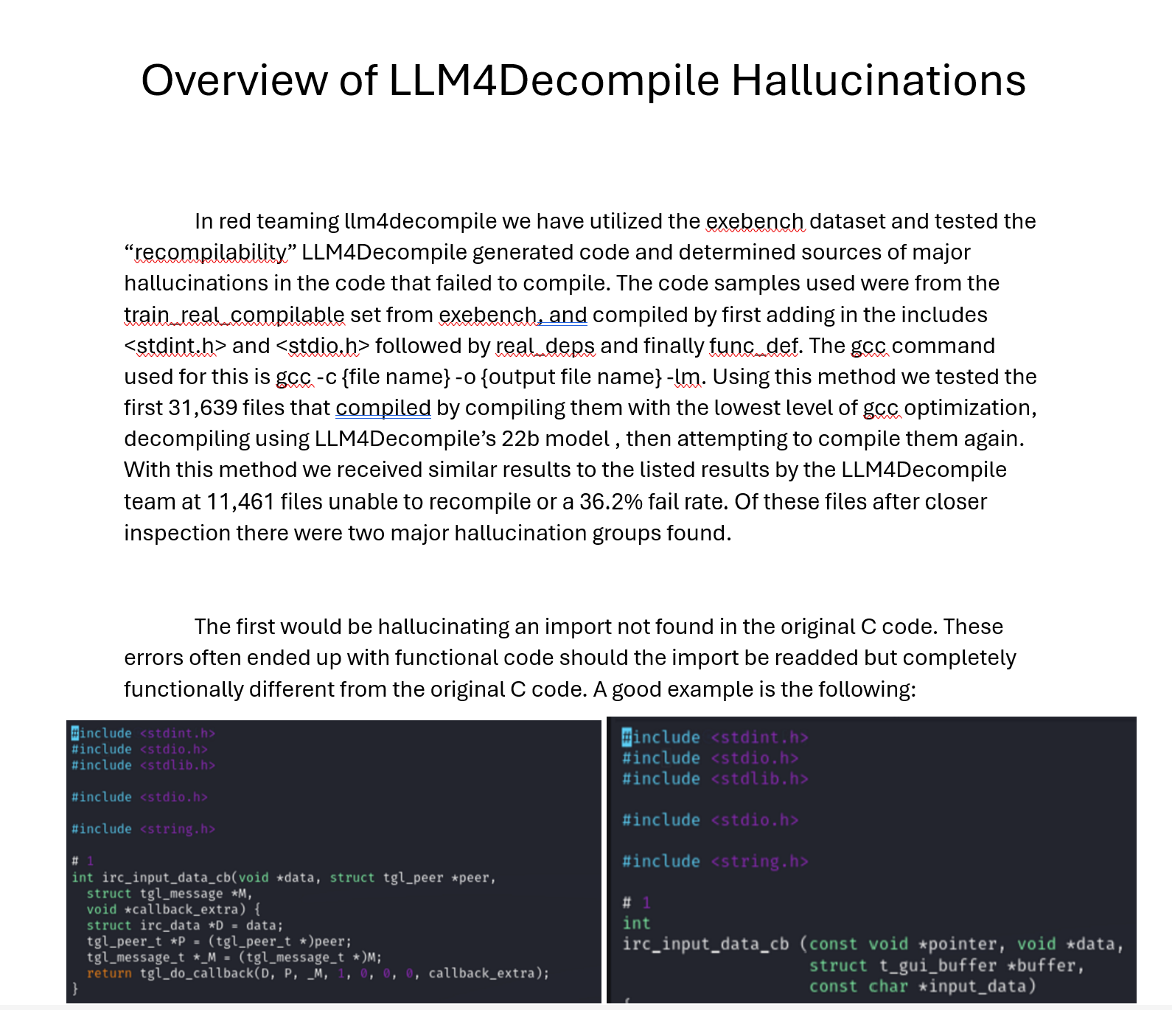
Red Team Report

Slide 9
Red Team (Mack, Max, Bisesh) Objectives – Next 2 weeks
Fix
Fix report for Dr. Arafin to be more presentable
Test
Test using a second LLM to improve the hallucinations (mistral nemo or codestral)
Do
Do the same analysis but with the 3 higher levels of GCC optimization

Slide 10
RAG Team (Craig, Justin) Objectives – Last 2 Weeks
Worked on development of database to be used in the RAG pipeline
Pulled .c and .asm files from exebench
Used .c files and gcc to create CFG of all files
Converted CFG into a JSON to be used for importing into Neo4j
Imported JSON of CFG into Neo4j
Finetuning the entire above process
Developed RAG input pipeline
Created vectorizing technique using codebert as an emedding model
Created database holding vectorized datasets and a parallel database of c functions.
Assessed likeness matching to find best embedding technique
Began work on input optimization for LLM4Decompile
RAG input layer works with DeepSeek coder and produces semi successful output without training
LLM4Decompile rejects complex input, began understanding how to train a new LLM4Decompile model

Slide 11
RAG Team (Craig, Justin) Objectives – Next 2 Weeks
Create a better CFG Map by refining input functions to get better relationships
1
Work towards using the Neo4J in the RAG pipeline
2
Create new input layers for LLM4Decompile that accepts multiple parameters (Files, Text, CFGs)
4
Use ChatGPT or Deepseek coder to better create an indexed database of assembled functions
5
Fine tune the Neo4j database for RAG use
3

Slide 12
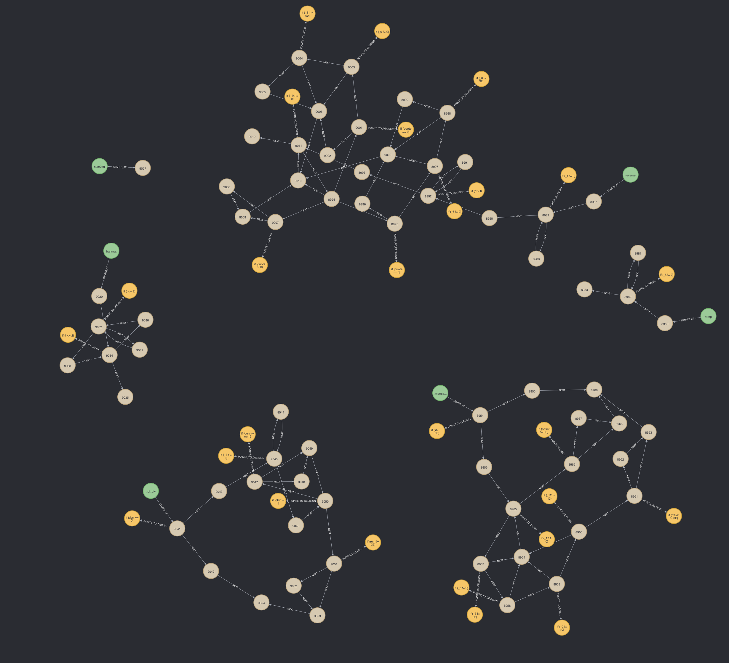
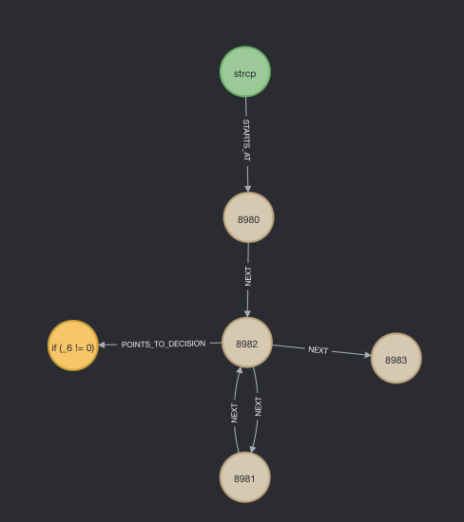
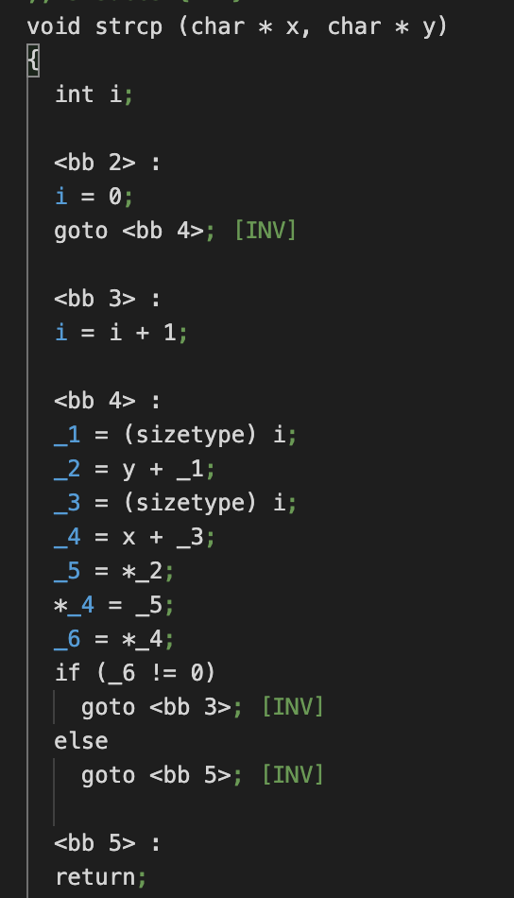
CFG Map

Slide 13
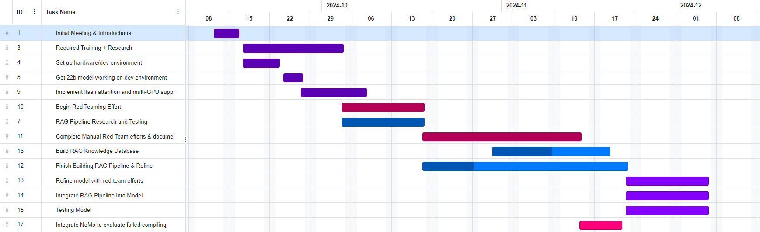
Gantt Chart – Phase 1

